Slide 1

Body Tracking Software
Using Augmented Reality ( AR )
PROJECT ID : S1_2021_19

Slide 2
Project Brief:
A clothing try on mobile application based on full body tracking using AR.
TEAM MEMBERS
Bibek Adhikari - 30376204 (Developer)
Pratik Maharjan - 30376695 (Designer)
Kathleen Mediavillo - 30376525 ( Project Manager)
Rachita Awal - 30377003 (Business Analyst and Researcher)

Slide 3
Stakeholders
SUPERVISOR
Mr. Vishal Saha
WORKSHOP FACILITATOR
Elizabeth Nain
CLIENT DETAILS
Parimal Kumar
Trigensoft Company
+91-9767343333
parimal@trigensoft.com

Slide 4
INTRODUCTION
Body Tracking Software is a iOS application built using Unity and ARkit where users can try outfits virtually using mobile camera that supports body tracking using AR.
On selecting outfit we enter AR scene where the outfit looks for part of body to be mapped.
This application also allows us to capture image while trying outfits and share them to social medias.

Slide 5
FEATURE
Select | Selecting the outfit that includes pants or shirt
Try In | Try the pant or shirt in AR view
Screenshot | Photo capturing : Screenshot function
Share | Share in social media

Slide 6
OBJECTIVES
This application is intended to reduce the cost and efforts of trying outfits using just a mobile application.
To reduce the number of product return.
To allow customers try outfits using mobile camera before actually doing the online shopping.
To detect the human body positions and body movements using smartphone camera.

Slide 7
PROBLEM STATEMENT
The customers are unable to check fitting on online shopping
Limits the idea of how clothes look like
Results in returning of the clothes
Greater loss for retailers as well as customers
Long queue in fitting rooms
Thus the proposed project helps in trying the clothes in AR with proper human body detection and movement tracking.

Slide 8
SIGNIFICANCE OF PRODUCT
Try the clothes in AR without physically trying is more convenient
Saves Time
Improved confidence in online shopping
Utilize the space of fitting rooms, increase sales and improve image of the store

Slide 9
RESEARCH PART (Literature Review)
Virtual Fitting Room
By ZeeKit
- Virtual garment adjusted to the body accordingly
- Sharing and purchasing function provides
- Analysis user’s body measurements
Webcam Social Shopper
- Overlays 2D image of garment over human body in real-time
- Motion capture system
- Sharing function across social media platforms
Dressing Room
By the Gap
- Generates a virtual avatar based on the height and weight allowing users to try the outfit
- Enables users to feel how the garment fit on the body

Slide 10
Critical Review of the existing product
The Zeekit app produce static image which cannot be viewed from different angles.
The WSS software has low accuracy and the virtual garment is not adjusted to the body accordingly.
In TheDressingRoom by Gap, there is difference between actual body and the avatar created.

Slide 11
TOOLS & TECHNOLOGIES USED
Softwares
Unity
Blender
Viro media
Viro react cli
React Native cli
HARDWARE
MAC laptop
IPHONE Xs or above
Designed by PoweredTemplate.com

Slide 12
METHODOLOGIES
Agile Methodology
Faster
Eliminates rework
Set priorities
Maintain small release cycles
SCRUM
Daily scrums
Product and Sprint backlogs
Peer Code Review and change

Slide 13
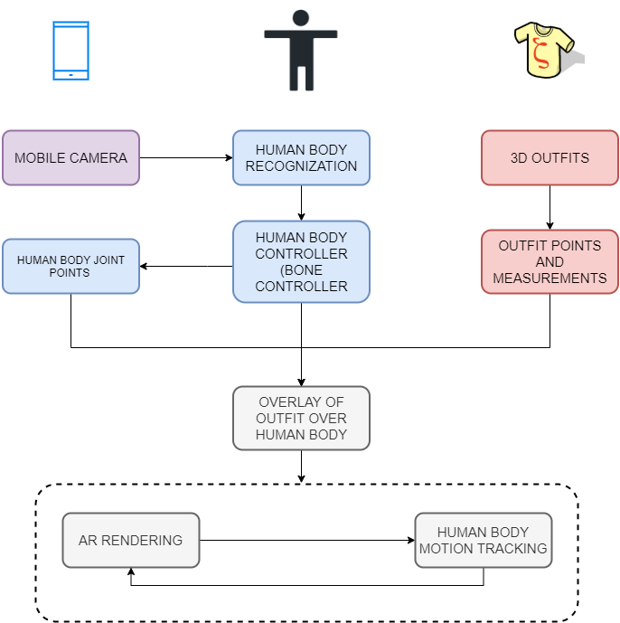
FLOWCHART

Slide 14
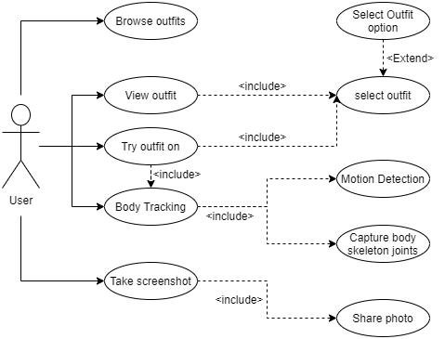
USE-CASE

Slide 15
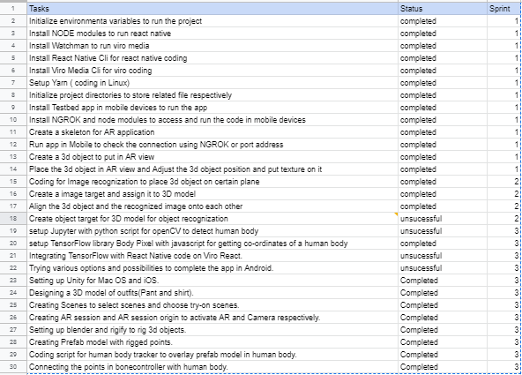
TASK
UNDERTAKEN

Slide 16
SCOPE
Programming language selection
Database selection and design
Full body outfit overlay
Virtual e-commerce app

Slide 17
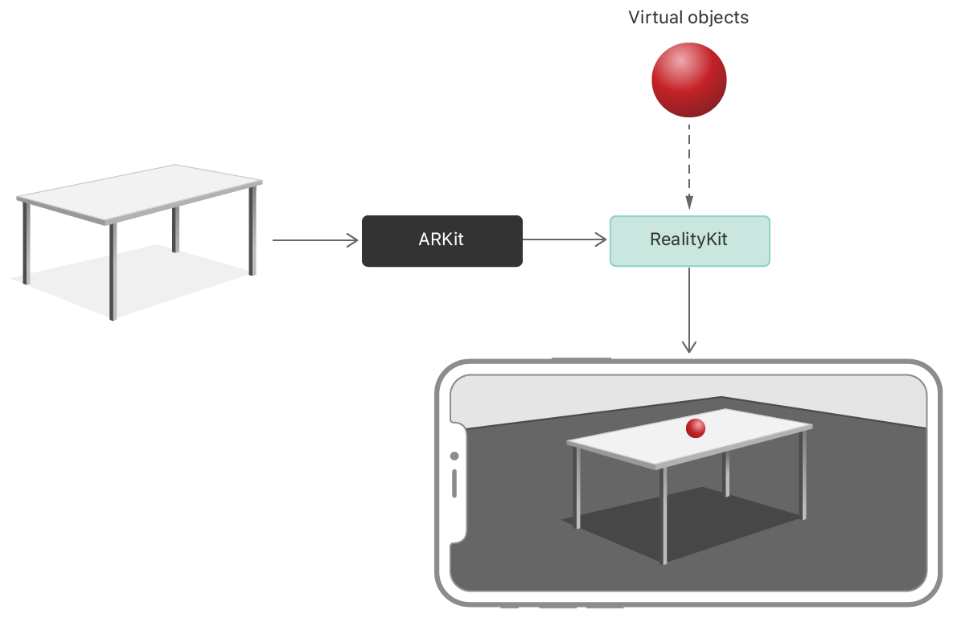
ARKIT

Slide 18
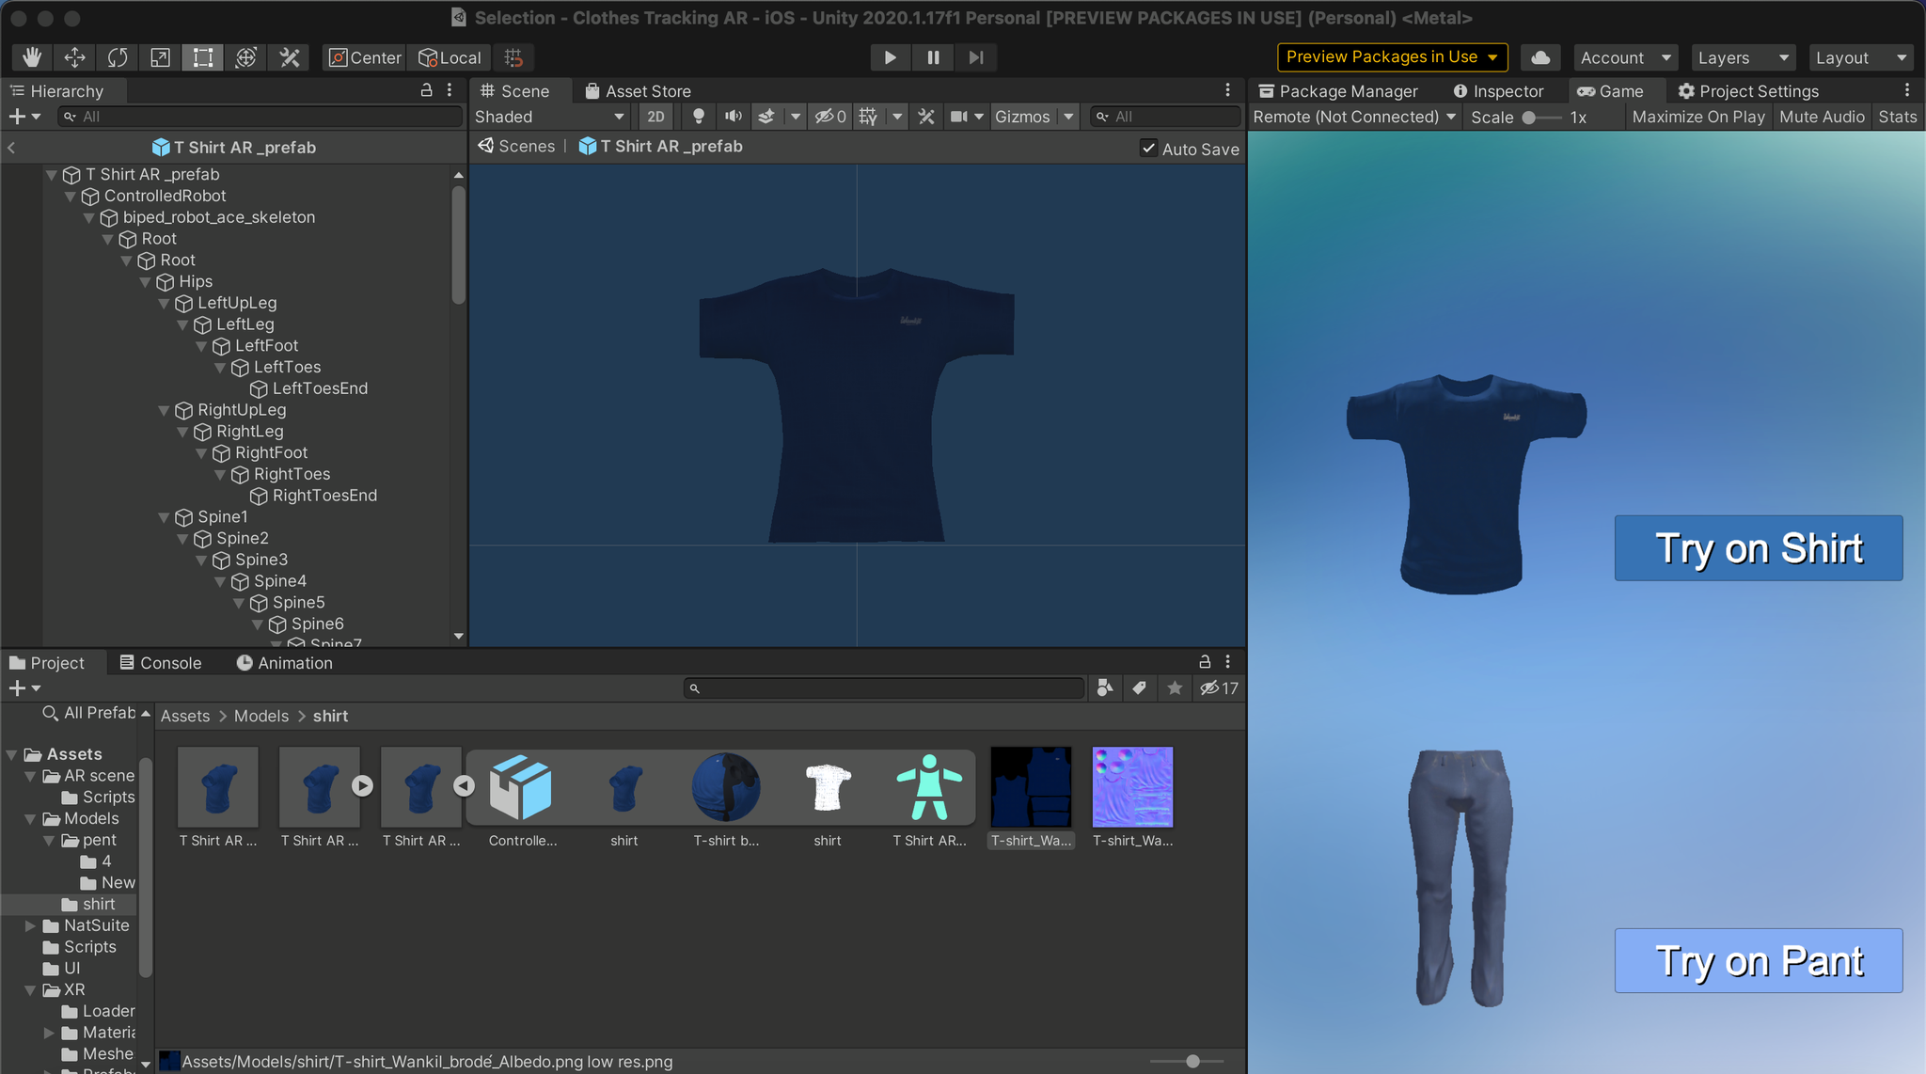
ShirtAR

Slide 19
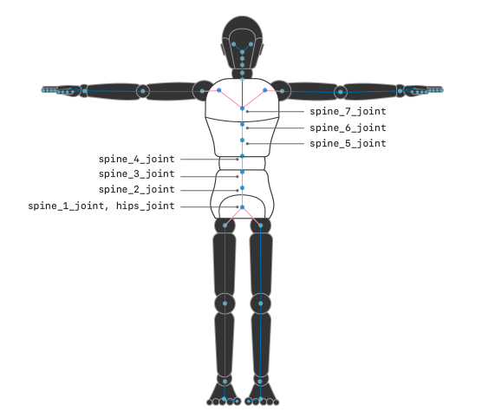
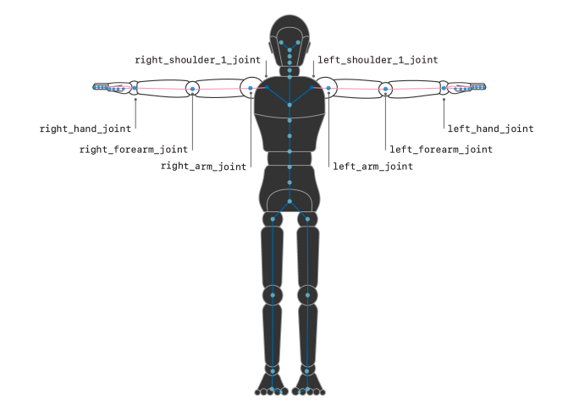
Shirt Prefab

Slide 20
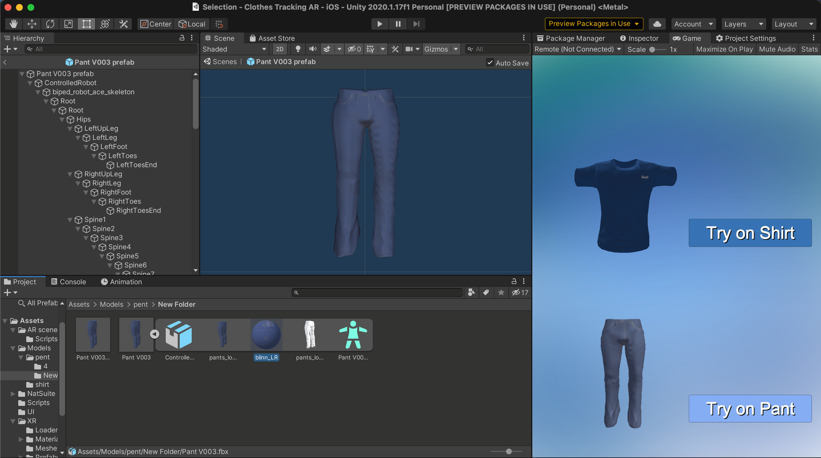
Pant AR

Slide 21
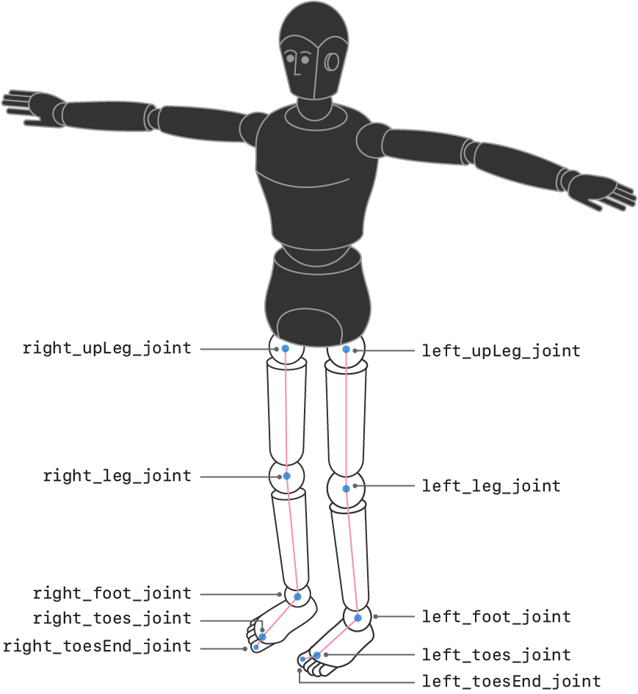
Pant Prefab

Slide 22
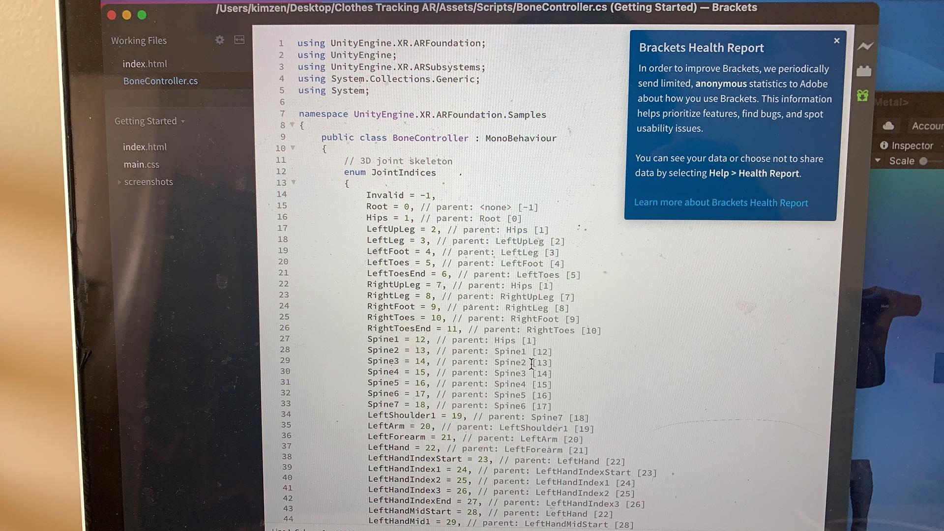
Bone Controller

Slide 23
CONCLUSION
Shopping for clothes is a tedious job as it can waste time for finding the perfect fit and standing in the long queue for payment as well.
Especially in this pandemic, the digital transformation is necessary for time saving and efficiency.
This project aims for developing the body tracking software that detects the human body positions and movements and customers can try on outfits virtually in a real time.
The users are able to try the clothes without going anywhere
The photo screenshot function is also available for future reference.
The app is user-friendly with a simple GUI where screenshot can also be shared through social media platform.
Designed by PoweredTemplate.com

Slide 24
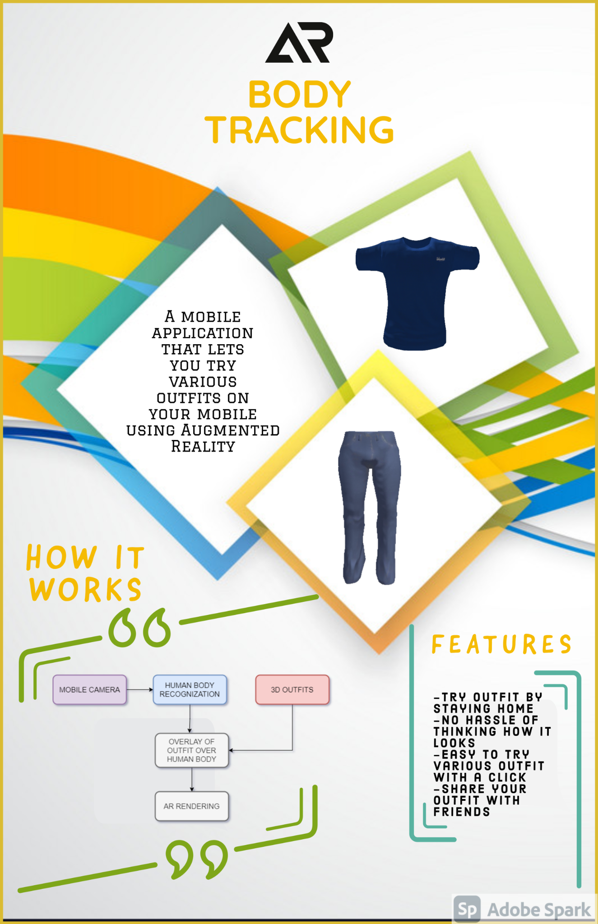
POSTER

Slide 25

PROMO VIDEO

Slide 26
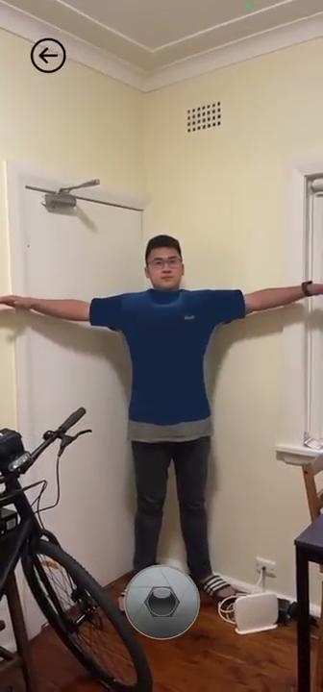
WALKTHROUGH VIDEO

Slide 27
THANK YOU

